Slide 1
Title: The Sanctity of life
Try to answer as many questions as possible. The aim is to score the most amount of points.
3) How reasonable is ‘eudaimonia’ as an ethical goal? Refer to Aristotle’s VE in your response
3) How successful is Aristotle’s virtue ethics at helping someone lead the good life?
2) name one Aristotelian virtue and that virtue’s vice of excess and deficiency
2) What does Aristotle believe about the purpose (telos) of human beings?
2) How are virtues cultivated?
1) Name one Aristotelian virtue
1) Where was Aristotle born?
1) What is the name of the school founded by Aristotle?
1) What is the Nicomachean ethics?

Slide 2
Sanctity of life
What does it mean to say that something or someone is ‘sacred?’
Can you think of an example of a sacred object?
Sanctity means ‘the quality of being sacred or holy.’
Notes:
If you are feeling super woo-woo. You could even have some sacred objects (from Rm 12) and place them around the classroom. Pupils could look at the objects (even pass them around) and consider what makes them sacred.

Slide 3
Now have a look at your quotation, stick it in your book, we are going to annotate it together.
3. What does this mean? What might be odd about this phrase? How could it be interpreted in different ways?
‘So God created mankind in his own image, in the image of God he created them; male and female he created them.
(Genesis 1.27)
1. Think back to year 7. What do Christians believe about God? What is God like?
1. What does this passage suggest about human beings?
2. What the implications of this passage? How might it make Christians feel, think and act?
2. In some translations this is translated as ‘people’. How does the different translations affect the meaning of the passage?

Slide 4
Now read the two other quotes from the sanctity of life
1. What do the passages suggest about human beings?
2. What the implications of these passages? How might it make Christians feel, think and act?
Now annotate this passage. Zooming in on the keywords and explaining what they mean.

Slide 5
Now annotate this passage. Zooming in on the keywords and explaining what they mean.
The word of the Lord came to me [Jeremiah], saying, “Before I formed you in the womb I knew you, before you were born I set you apart; I appointed you as a prophet to the nations’ (Jeremiah 1.3-5)
1. What does this passage suggest about human beings?
2. What the implications of this passage? How might it make Christians feel, think and act?

Slide 6
One of the teachers of the law came and heard them debating. Noticing that Jesus had given them a good answer, he asked him, “Of all the commandments, which is the most important? “The most important one,” answered Jesus, “is this: ‘Hear, O Israel: The Lord our God, the Lord is one.Love the Lord your God with all your heart and with all your soul and with all your mind and with all your strength. The second is this: ‘Love your neighbor as yourself. There is no commandment greater than these.” (Mark 12.28-31)
Now annotate this passage. Zooming in on the keywords and explaining what they mean.
1. What does this passage suggest about human beings?
2. What the implications of this passage? How might it make Christians feel, think and act?

Slide 7
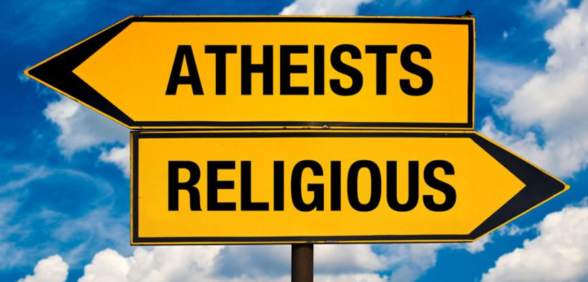
Discuss: Can you believe in the sanctity of life without God?

Slide 8
What are human rights? What rights would Christians and Humanists agree upon - would they agree upon these human rights for the same reason?
Humanism -Human rights and equality
Humanism is not a religion, but a worldview.
Humanists do not believe in God because they argue that there is not valid evidence for the existence of God.
Humanists do not believe that Humans were created by God.
This does not mean that human life is not important. Humanists are Utilitarian in their philosophy. They believe that humans should look after each other because it is better for the happiness of the majority of people.
Christianity
‘So God created mankind in his own image, in the image of God he created them; male and female he created them’‘
(Genesis 1.27)
Notes:
For Humanist view - UN declaration of human rights

Slide 9
What are human rights? What rights would Christians and Humans agree upon - would they agree upon these human rights for the same reason?
Humanism -Human rights and equality
Humanism is not a religion, but a worldview.
Humanists do not believe in God because they argue that there is not valid evidence for the existence of God.
Humanists do not believe that Humans were created by God.
This does not mean that human life is not important. Humanists are Utilitarian in their philosophy. They believe that humans should look after each other because it is better for the happiness of the majority of people.
Christianity
Sanctity of life
Rights a Christian and Humanist would agree upon

Slide 10
Write one paragraph explaining religious and non-religious beliefs about the sanctity of life. Use the quotes we have looked at to help you and include the keywords.
Connecting words
Because
But
So
Humanist manifesto III ‘ We are committed to treating each person as having inherent worth and dignity, and to making informed choices in a context of freedom and responsibility.’

Slide 11
Discuss: What are the implications of belief in the sanctity of life?

Slide 12
‘So God created mankind in his own image, in the image of God he created them; male and female he created them.
(Genesis 1.27)
The word of the Lord came to me [Jeremiah], saying, “Before I formed you in the womb I knew you, before you were born I set you apart; I appointed you as a prophet to the nations’ (Jeremiah 1.3-5)
One of the teachers of the law came and heard them debating. Noticing that Jesus had given them a good answer, he asked him, “Of all the commandments, which is the most important? “The most important one,” answered Jesus, “is this: ‘Hear, O Israel: The Lord our God, the Lord is one.Love the Lord your God with all your heart and with all your soul and with all your mind and with all your strength. The second is this: ‘Love your neighbor as yourself. There is no commandment greater than these.” (Mark 12.28-31)
‘So God created mankind in his own image, in the image of God he created them; male and female he created them.
(Genesis 1.27)
The word of the Lord came to me [Jeremiah], saying, “Before I formed you in the womb I knew you, before you were born I set you apart; I appointed you as a prophet to the nations’ (Jeremiah 1.3-5)
One of the teachers of the law came and heard them debating. Noticing that Jesus had given them a good answer, he asked him, “Of all the commandments, which is the most important? “The most important one,” answered Jesus, “is this: ‘Hear, O Israel: The Lord our God, the Lord is one.Love the Lord your God with all your heart and with all your soul and with all your mind and with all your strength. The second is this: ‘Love your neighbor as yourself. There is no commandment greater than these.” (Mark 12.28-31)
‘So God created mankind in his own image, in the image of God he created them; male and female he created them.
(Genesis 1.27)
The word of the Lord came to me [Jeremiah], saying, “Before I formed you in the womb I knew you, before you were born I set you apart; I appointed you as a prophet to the nations’ (Jeremiah 1.3-5)
One of the teachers of the law came and heard them debating. Noticing that Jesus had given them a good answer, he asked him, “Of all the commandments, which is the most important? “The most important one,” answered Jesus, “is this: ‘Hear, O Israel: The Lord our God, the Lord is one.Love the Lord your God with all your heart and with all your soul and with all your mind and with all your strength. The second is this: ‘Love your neighbor as yourself. There is no commandment greater than these.” (Mark 12.28-31)

Slide 13
UN Declaration of Human Rights (some of them).
UN Declaration of Human Rights (some of them).
Article 1 All human beings are born free and equal in dignity and rights. They are endowed with reason and conscience and should act towards one another in a spirit of brotherhood.
Article 2 Everyone is entitled to all the rights and freedoms set forth in this Declaration, without distinction of any kind, such as race, colour, sex, language, religion, political or other opinion, national or social origin, property, birth or other status. Furthermore, no distinction shall be made on the basis of the political, jurisdictional or international status of the country or territory to which a person belongs, whether it be independent, trust, non-self-governing or under any other limitation of sovereignty.
Article 3 Everyone has the right to life, liberty and security of person.
Article 4 No one shall be held in slavery or servitude; slavery and the slave trade shall be prohibited in all their forms.
Article 5 No one shall be subjected to torture or to cruel, inhuman or degrading treatment or punishment.
Article 6 Everyone has the right to recognition everywhere as a person before the law
Article 1 All human beings are born free and equal in dignity and rights. They are endowed with reason and conscience and should act towards one another in a spirit of brotherhood.
Article 2 Everyone is entitled to all the rights and freedoms set forth in this Declaration, without distinction of any kind, such as race, colour, sex, language, religion, political or other opinion, national or social origin, property, birth or other status. Furthermore, no distinction shall be made on the basis of the political, jurisdictional or international status of the country or territory to which a person belongs, whether it be independent, trust, non-self-governing or under any other limitation of sovereignty.
Article 3 Everyone has the right to life, liberty and security of person.
Article 4 No one shall be held in slavery or servitude; slavery and the slave trade shall be prohibited in all their forms.
Article 5 No one shall be subjected to torture or to cruel, inhuman or degrading treatment or punishment.
Article 6 Everyone has the right to recognition everywhere as a person before the law

